Slide 1
Cooler as smart, better as a postbox.
Logoleiste

Slide 2
What problems do we want so solve?

Slide 4
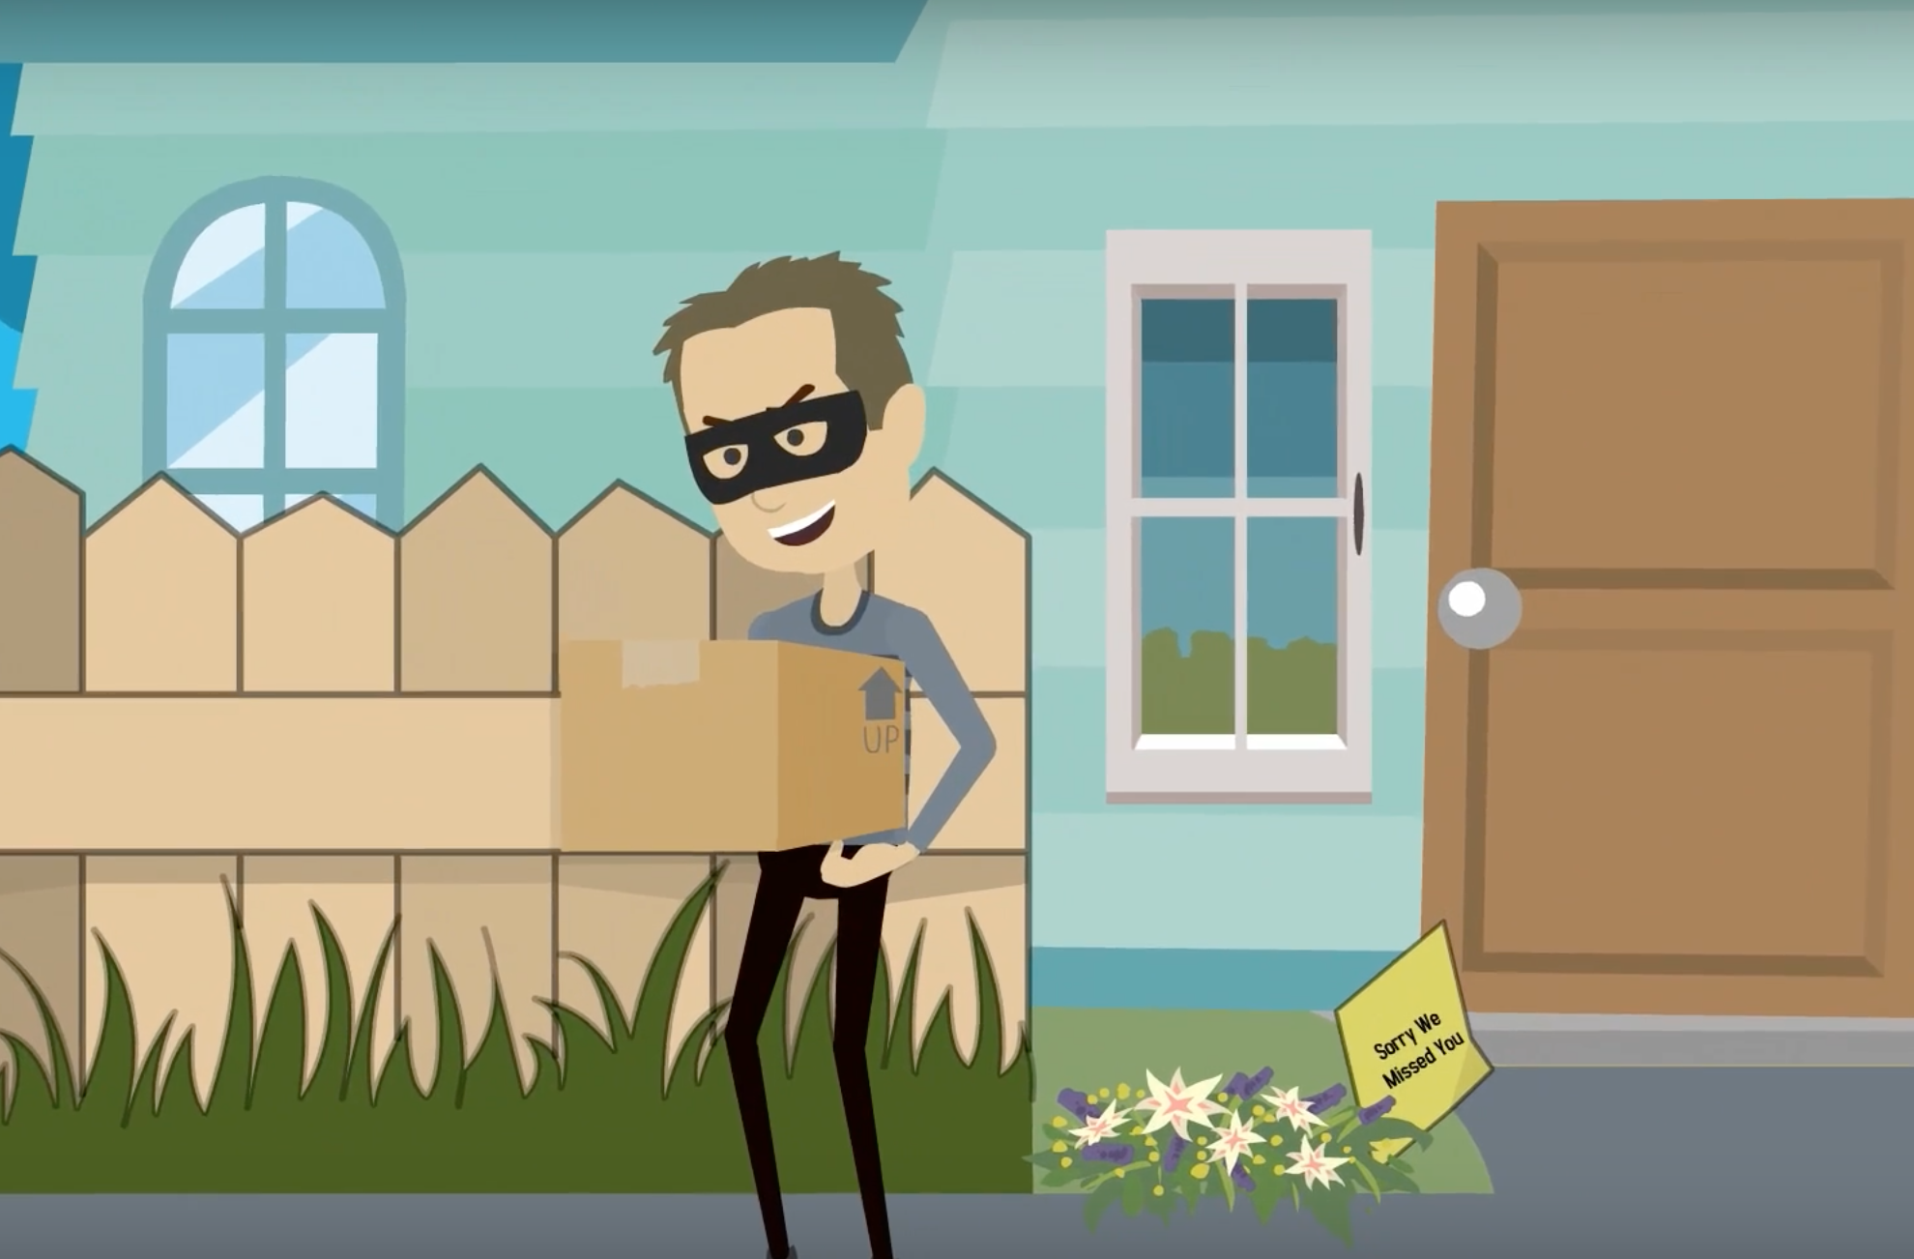
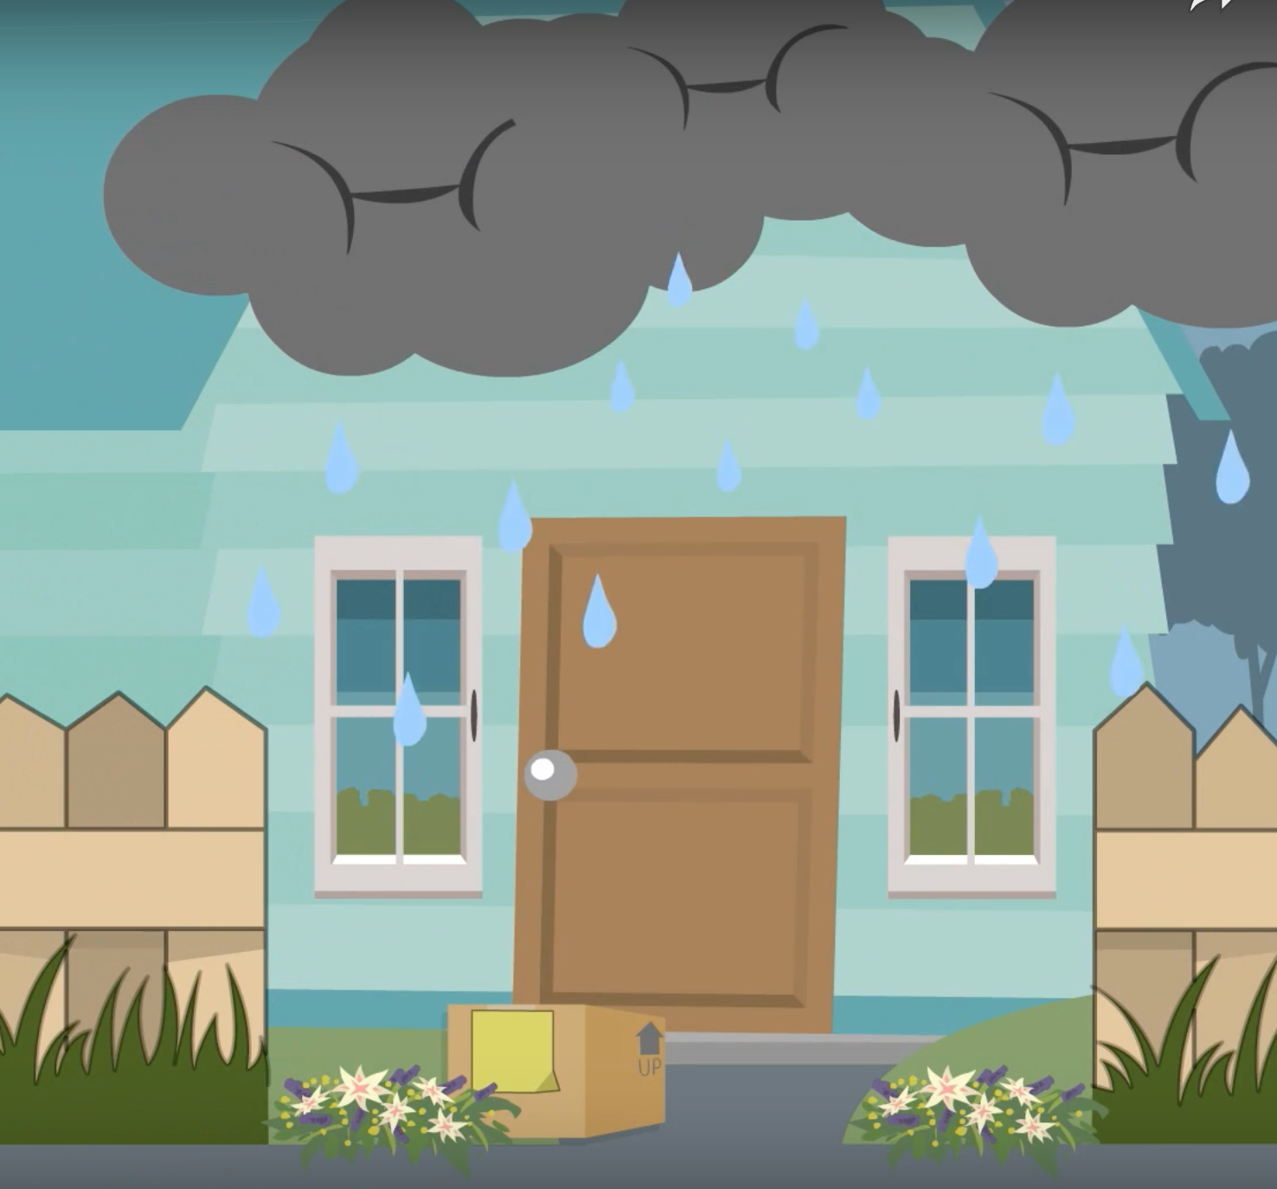
And what if there would be something inside which recuires constant cooling?

Slide 6
... and last but not least

Slide 8
Our solution:
A remote administration solution for the IoT delivery Box (Postingo) in the 21st century

Slide 9
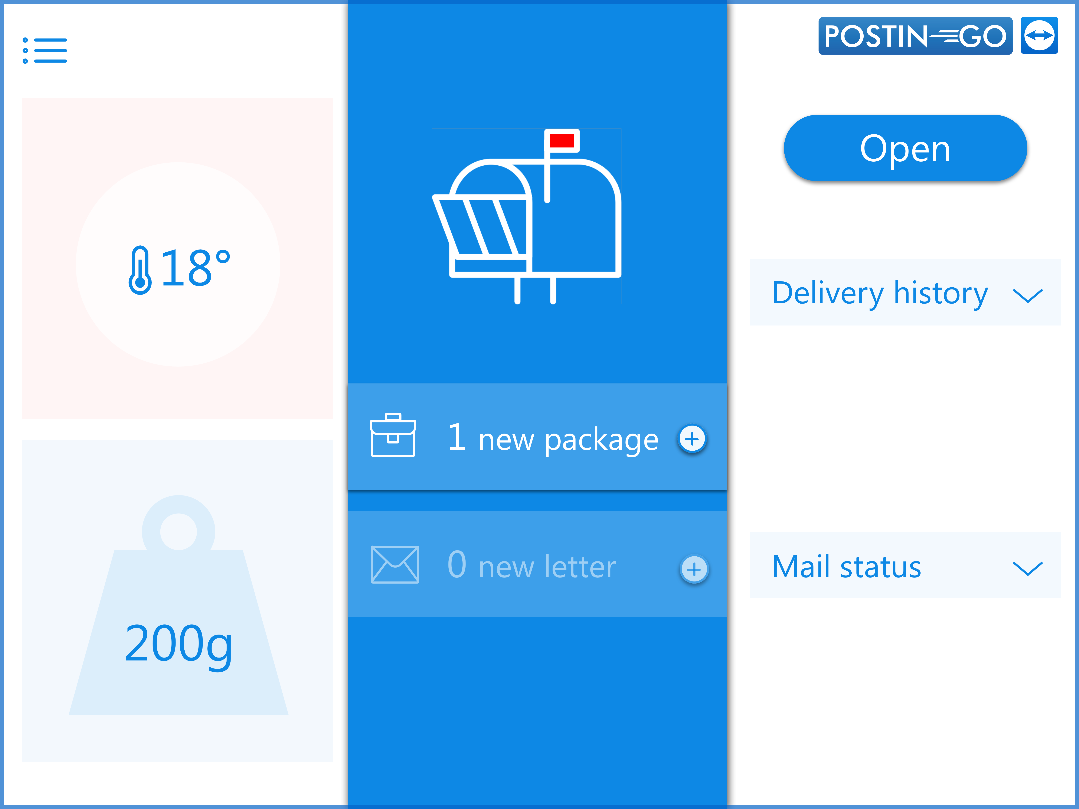
1. Sends you notice when receiving new letters or packages

Slide 10
1. Sends you notice when receiving new letters or packages

Slide 11
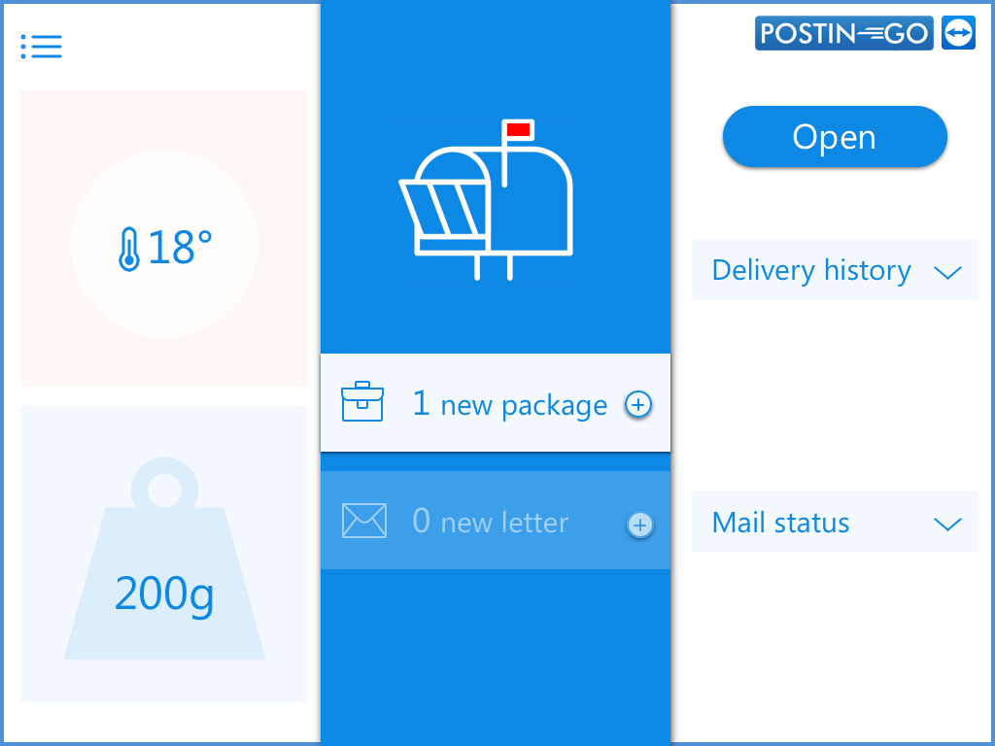
1. Sends you notice when receiving new letters or packages

Slide 12
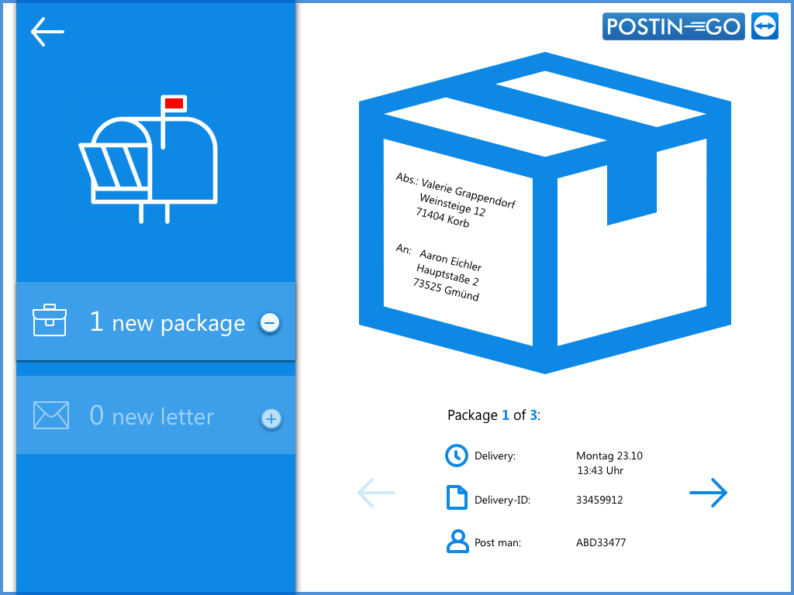
1. Sends you notice when receiving new letters or packages

Slide 13
1. Sends you notice when receiving new letters or packages

Slide 14
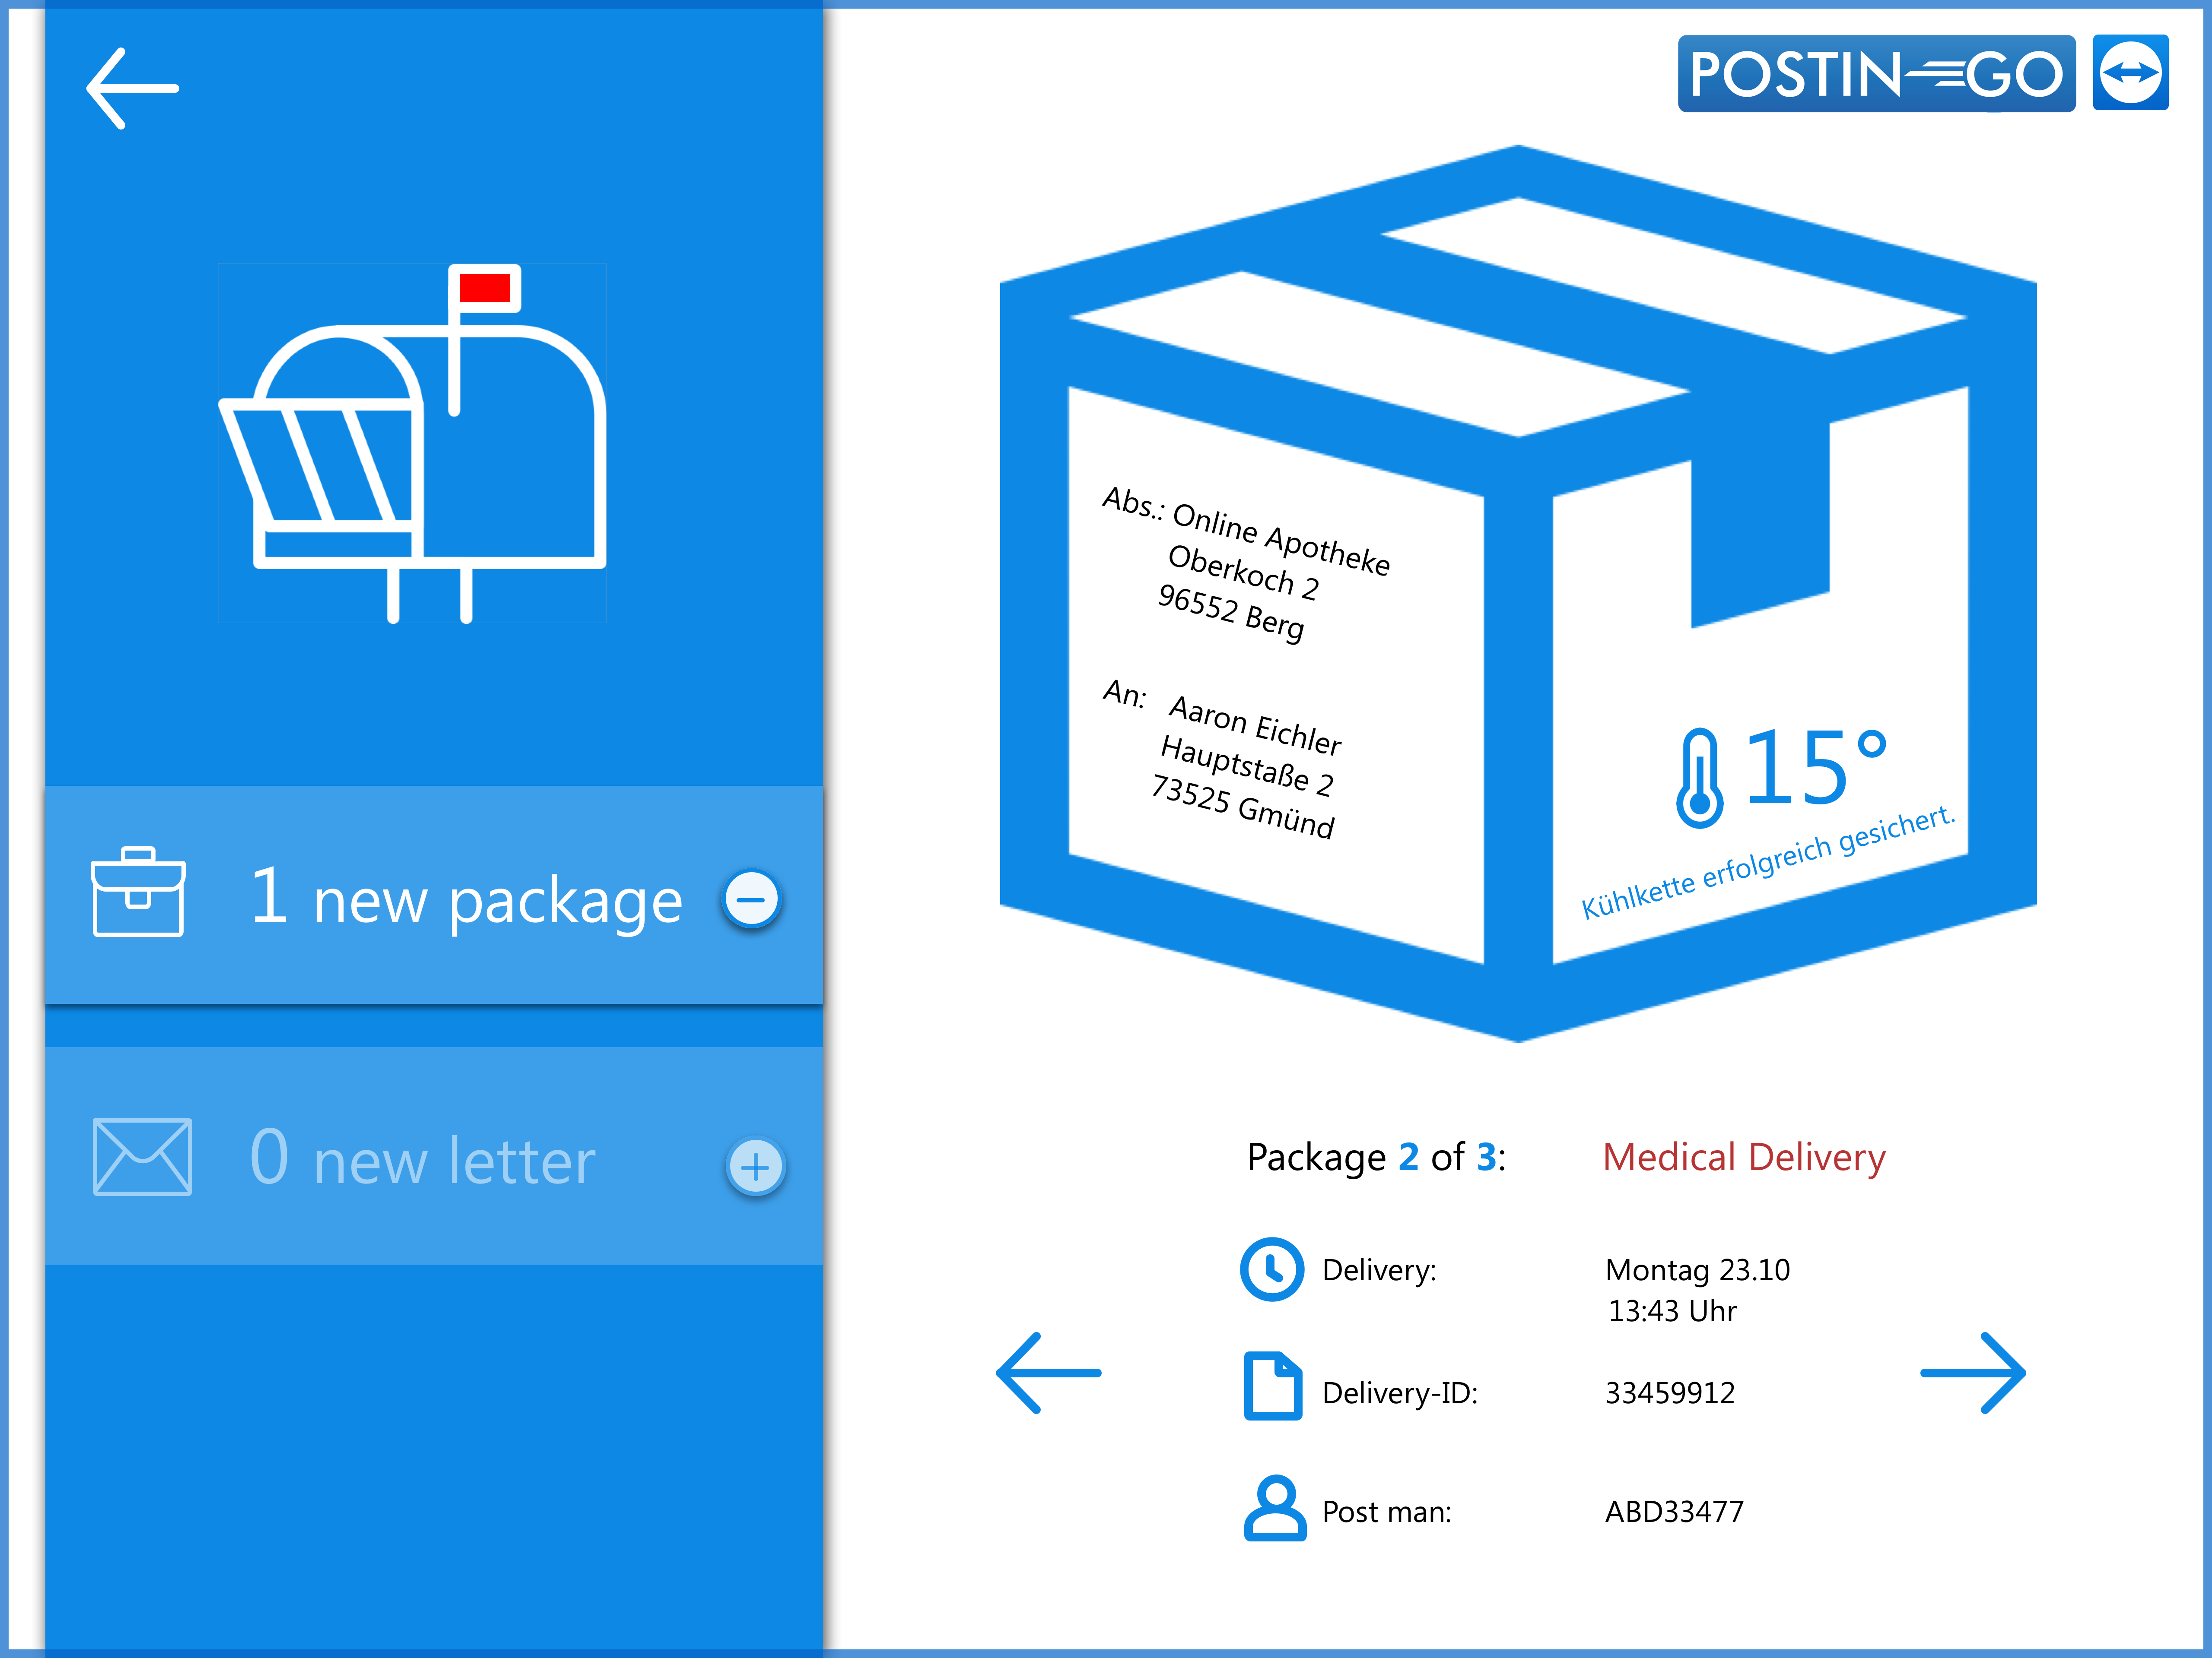
1. Sends you notice when receiving new letters or packages

Slide 15
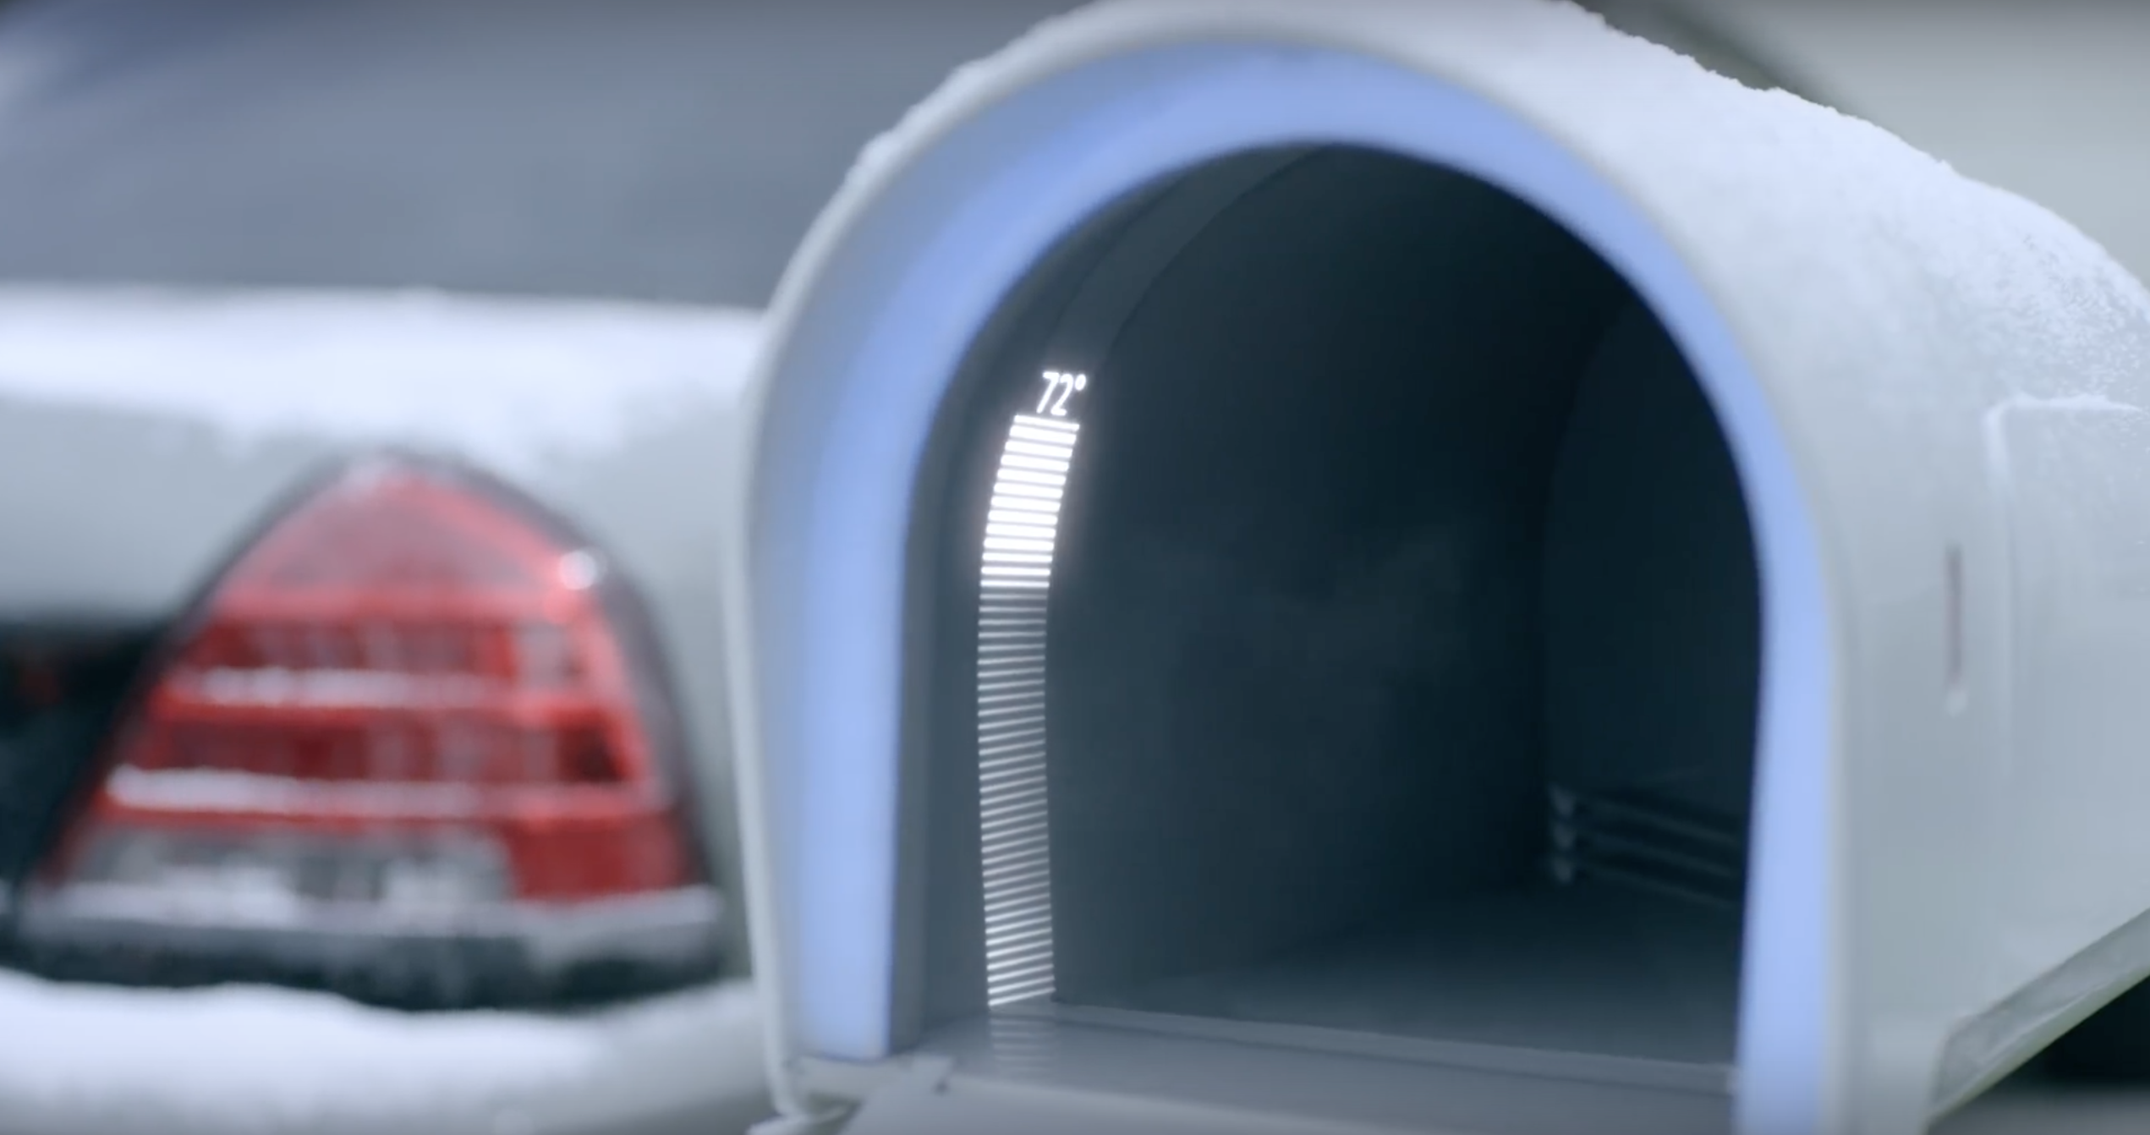
2. Temperature system to control a constant cooling chain for special deliverys

Slide 16
3. Security box system potects packages from thiefs and weather
4. Pick up station, which safes you your trip to the next post office

